Slide 1
Shell Bootcamp 2024 3 Reflections for Week 2
Deepika Srivastava
Date : 06-Sept-2024

Slide 2

About Me
Don’t just dream but AIM.
Promising myself everyday to be a better person tomorrow than I was today.
Please share an image / visual that best represents you

Slide 3

My learnings from this week!

Slide 4
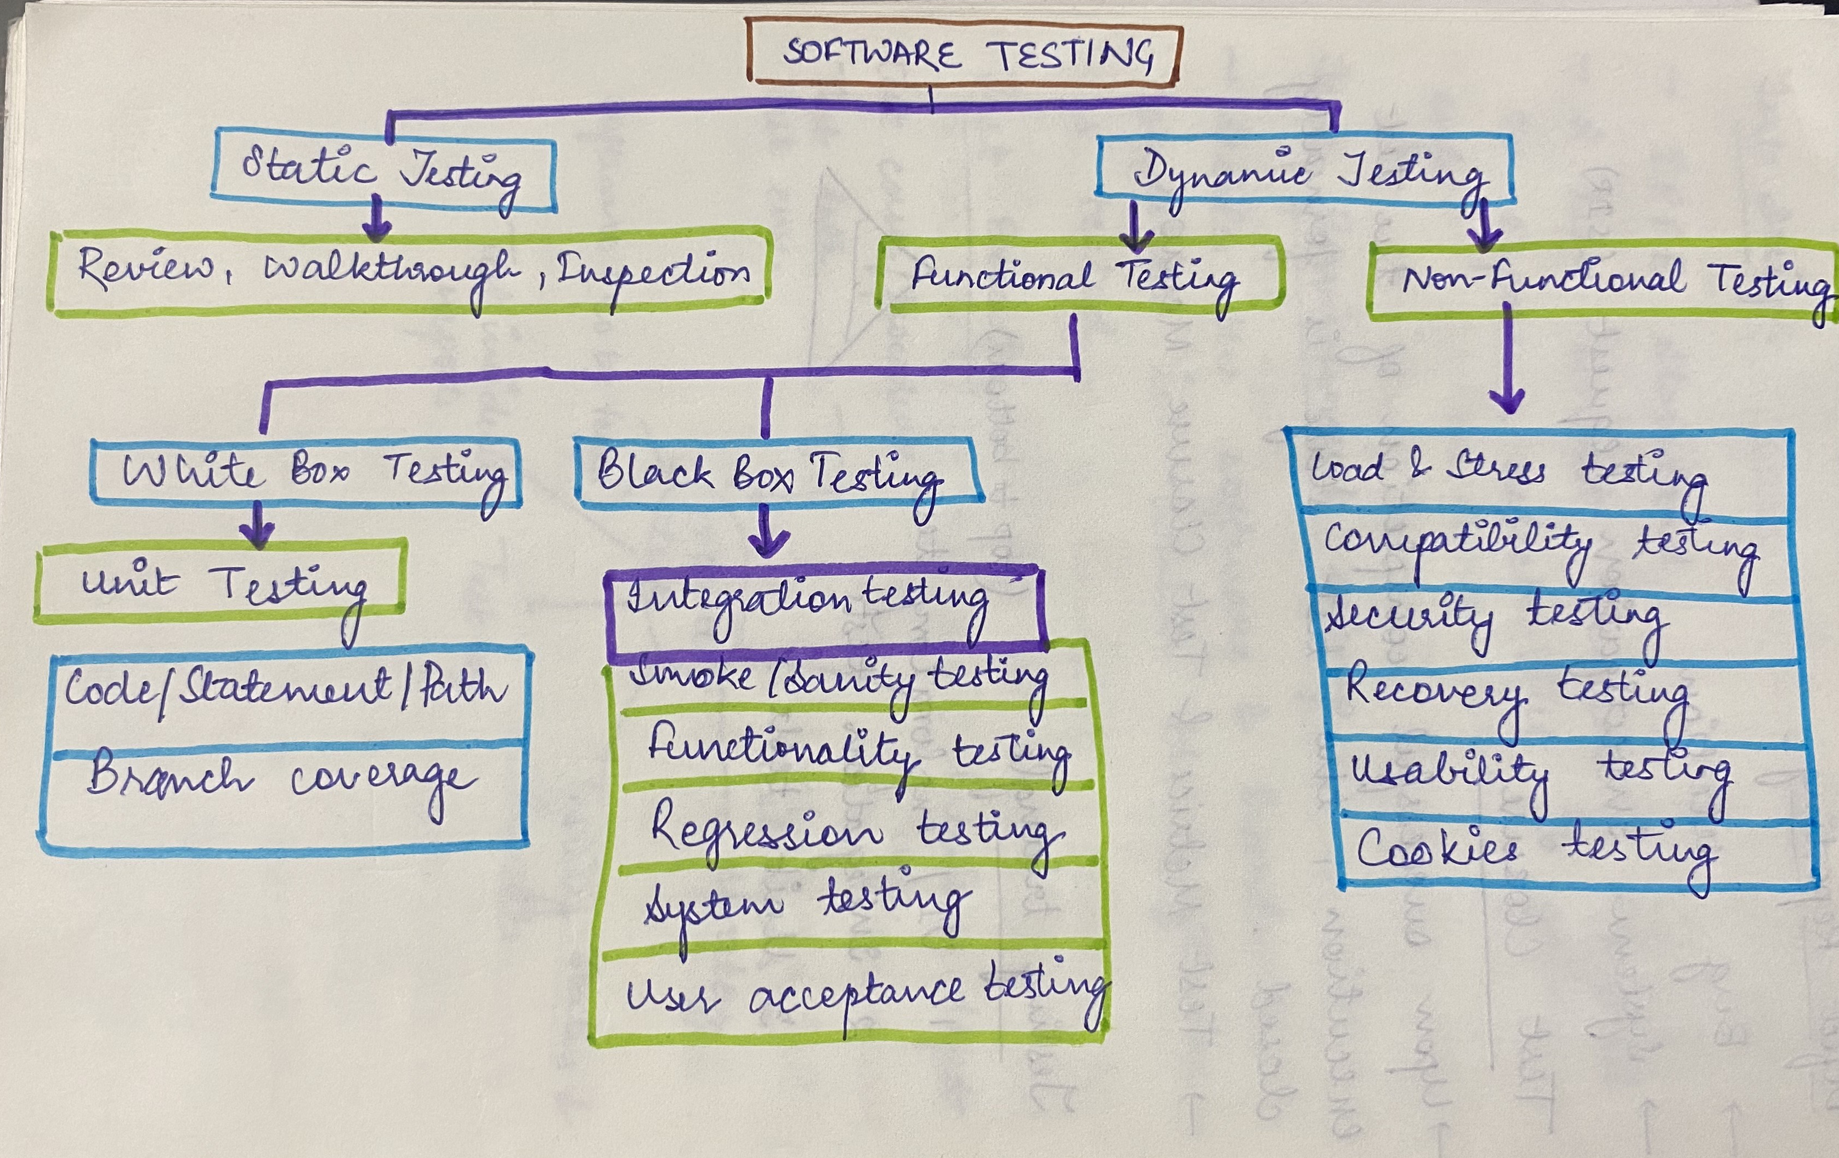
Learning 1 | My takeaways | Testing
What is test?
Software Testing
Software Testing Life Cycle
Test Strategy
Test Plan
Test Design
Test Environment Setup
Test Execution
Defect Reporting
Test Closure
Testing Triangle
Automation Testing
POWER Technique
Plan Organize Write Edit Review

Slide 5
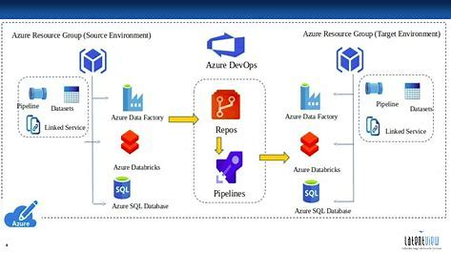
Learning 2 | My takeaways | DevOps and Azure
DevOps : It is a culture to promote development and operations collaboratively.
DevOps Lifecycle and Tools.
CI/CD Pipeline
Github Actions: Automates everything with the Github flow (Theory+Practicals)
Components of Github Actions : Workflows, Events, Jobs, Actions and Runners
Cloud Platform
IaaS, PaaS, SaaS
Cloud Infrastructure Components
Virtual Machine (Theory and Practical)

Slide 6
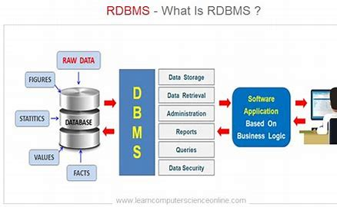
Learning 3 | My takeaways | RDBMS
What is RDBMS? : Relational Database Management System
Types of Databases
PostGreSQL
SQL Commands
Syntaxes
Functions in SQL

Slide 7

Relevance of learnings for my organization

Slide 8
Learning 1 | Relevance for Shell
In my role as a software engineer at Shell, incorporating testing into my daily workflow is crucial for ensuring high-quality software.
Starting by writing automated unit tests to validate individual components and integrate them into your CI/CD pipeline for continuous validation.
Applying integration and system tests to ensure that different parts of your application work together seamlessly. Employing performance testing to identify and address potential bottlenecks.
Additionally, using exploratory testing to uncover edge cases and unexpected issues. Maintaining comprehensive test documentation and review test results regularly to drive improvements. Embracing these practices will enhance code reliability, reduce bugs, and streamline development.

Slide 9
Learning 2 | Relevance for Shell
Incorporating DevOps and Azure into my daily software engineering tasks at Shell can streamline development and operations. Using Azure DevOps to automate our build and deployment pipelines, ensuring consistent and reliable releases. Implementing infrastructure as code with Azure Resource Manager templates to manage resources efficiently. Leverage Azure Monitor for real-time application performance insights and proactive issue resolution. Utilizing Azure Repos for version control and collaborate with team members through Azure Boards for tracking work items and managing agile processes. By integrating these tools and practices, I can enhance code quality, accelerate delivery, and maintain operational excellence.

Slide 10
Learning 3 | Relevance for Shell
In my role as a software engineer at Shell, using RDBMS (Relational Database Management Systems) can greatly enhance data management and application development. Regularly designing and optimize relational schemas to ensure efficient data storage and retrieval. Write and execute SQL queries to interact with databases, perform data analysis, and generate reports. Implement transactions and indexing to maintain data integrity and improve performance. Use database management tools for backup, recovery, and monitoring to ensure data security and availability. By effectively leveraging RDBMS, you can build scalable applications, maintain robust data integrity, and streamline data-driven decision-making processes.

Slide 11

Challenges in implementing learning

Slide 12
Challenge faced while implementing Learning 1
Writing test cases and automating manual testing.

Slide 13
Challenge faced while implementing Learning 2
DevOps is a new technology that I came across and given its importance, it was crucial to learn. I faced certain challenges navigating through the dashboards and portal but once it became familiar it was easy to use and navigate. It made my work look systematic as well when I designed a sprint.

Slide 14

Action Plan

Slide 15
My Action Plan for this Week
Actions
Timeline
Status
Technical Training
BA, Agile, DevOps, Cloud, RDBMS
Practicing DevOps and Github Actions
Learning

Slide 16

Learning is also Fun!

Slide 17
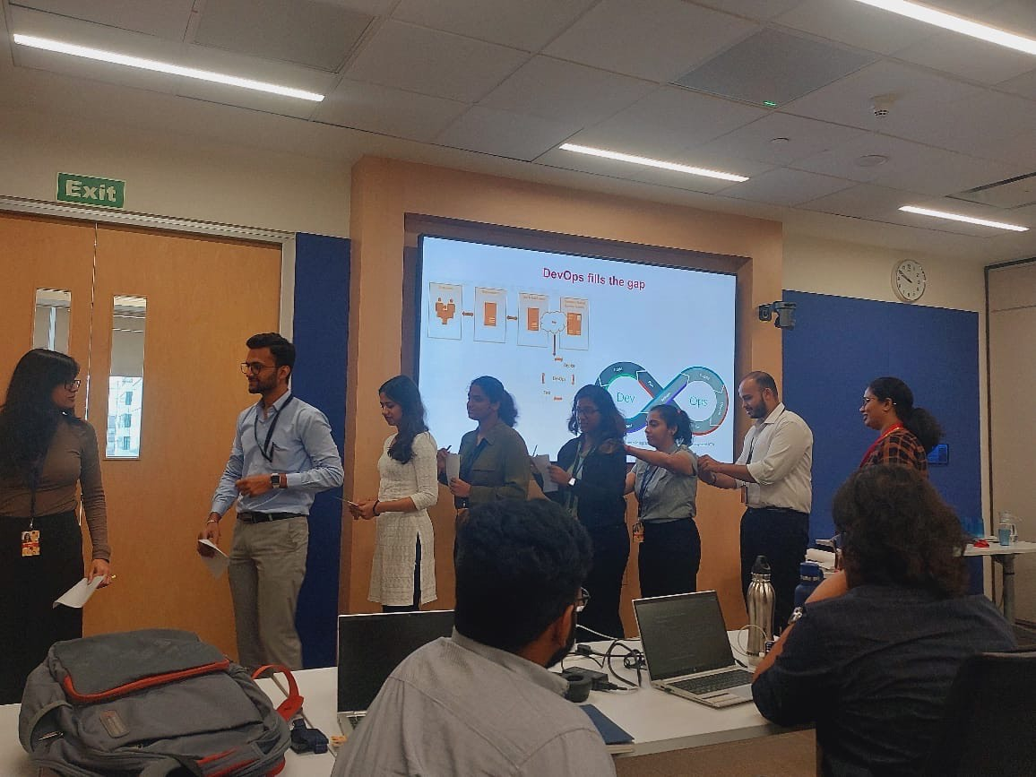
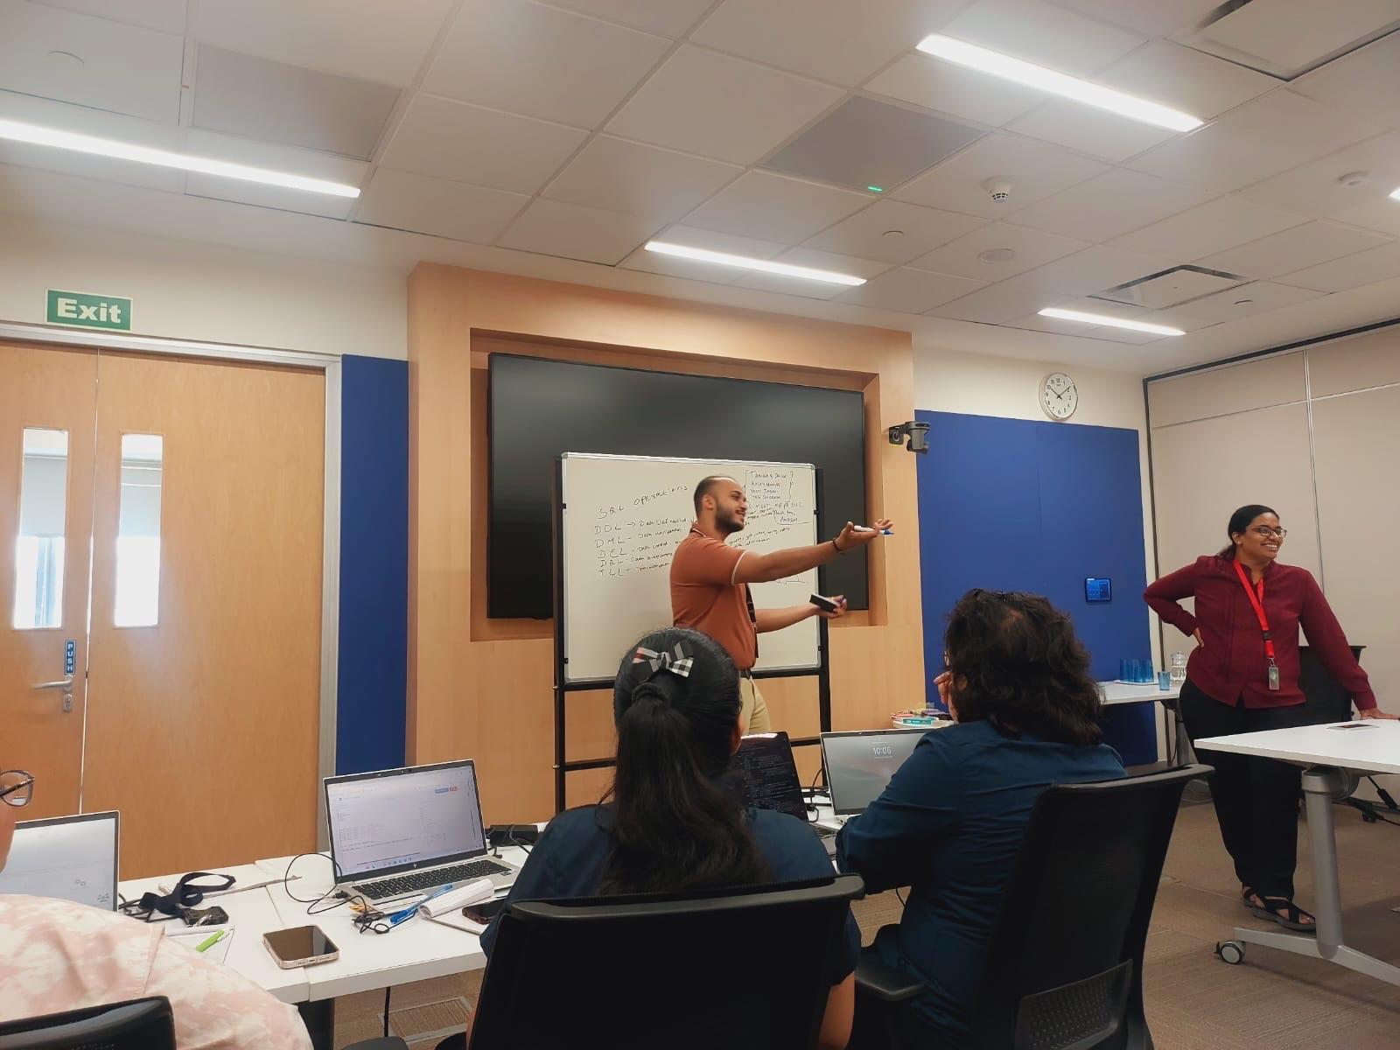
Learning is also Fun!

Slide 18

Summary
Crucial technical topics were discussed.
Be clear about the concepts and learn its practical application.
Will be beginning with department specific training.

Slide 19
Thank You

